Slide 1
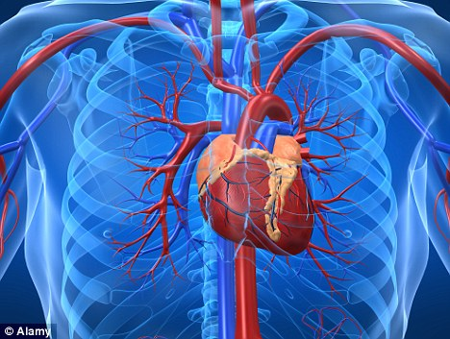
Cardiovascular System

Slide 2
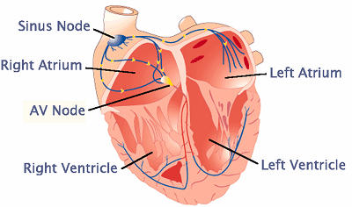
Parts of the Heart
Atrium: Also known as Auricles. the smaller superior chambers of the heart where blood collects either from the body or the lungs.
Ventricle: these are the larger chambers that collect the blood from the atriums.

Slide 3
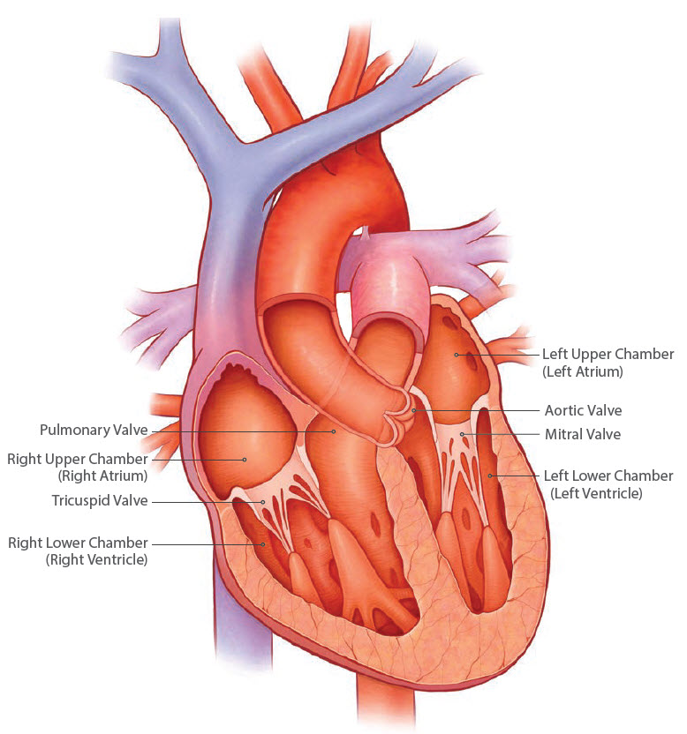
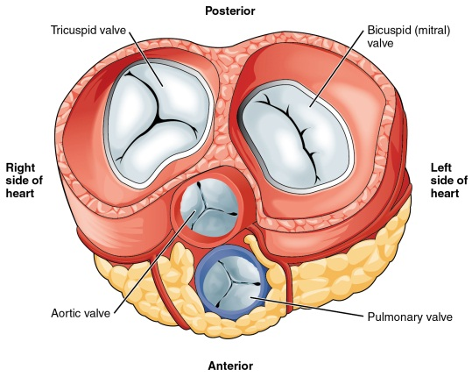
Parts of the Heart
Bicuspid Valves ( Mitral bishops hat or miter) these are Atrioventricular valves that are located between the left atrium and left ventricles.
Tricuspid valves: three cusps found between the right atrium and right ventricle.

Slide 4
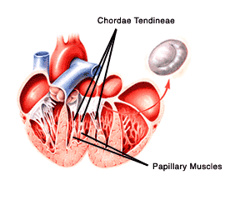
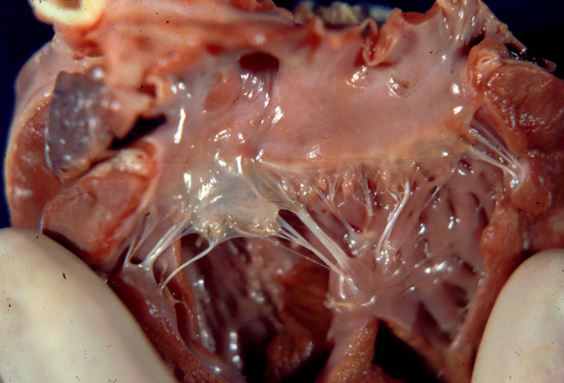
Parts of the Heart
Papillary muscles : cone shaped muscles of the ventricle.
Chordae Tendineae: the strong connective tissue that are attached to the papillary muscles.

Slide 5
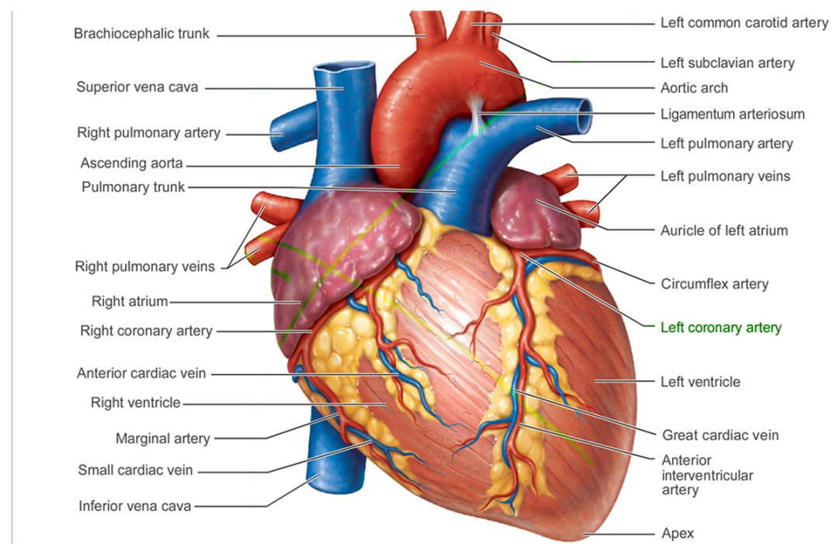
Parts of the Heart
Pulmonary Artery: The vein that carries deoxygenated blood from the heart to the lungs
Pulmonary Vein: The artery that carries oxygenated blood from the lungs to the heart.

Slide 6
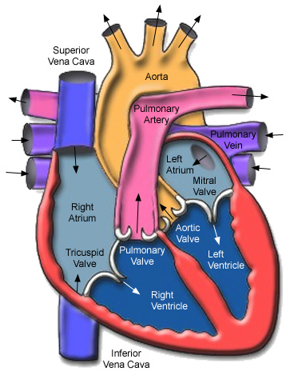
Parts of the Heart
Aorta: Largest blood vessel of the body.
Runs very deep.
Carries oxygenated blood to the body
Ascending Aorta: Runs to the head and brain.
Descending Aorta: Runs to the abdomen and the legs
Aortic Arch: Portion of the aorta that runs around the heart.
The ascending and decending aortas branch off from here.

Slide 7
Parts of the Heart
Vena Cava: The largest vein of the body.
Superior Vena Cava : The portion that carries blood back from the head and chest region.
Inferior Vena Cava: the portion that carries blood back from the abdomen and legs.
These come together to form the vena cava.

Slide 8
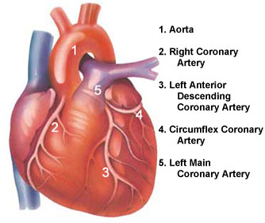
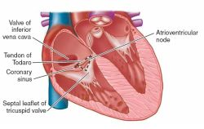
Parts of the Heart
Coronary Artery: the artery that supplies the heart with oxygen.
Coronary Sinus holds the blood from the coronary veins. Then sends the blood into the right atrium. Located on the Posterior portion of the heart.

Slide 9
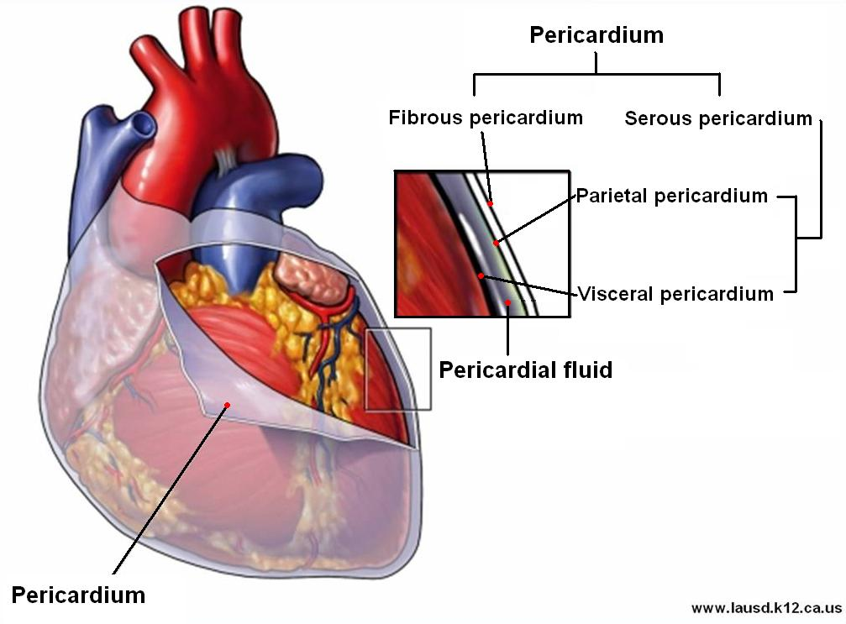
Parts of the Heart
Pericardium:
Fibrous Pericardium: Outer layer Prevents the heart from moving. Protects the heart
Serous Pericardium: Double layer. Parietal or outer layer.
Visceral / Epicardium:
Paricardial Fluid and Paricardial Cavity:

Slide 10
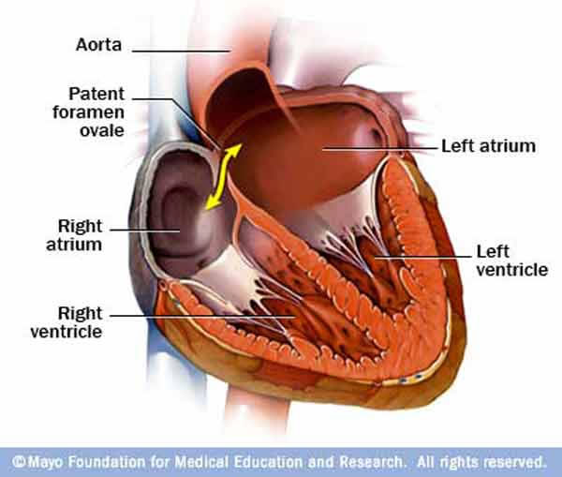
Parts of the Heart
Interatrial Septum the area between the atrium
Foramen Oval/ Foramen Ovalis: the opening between the atrium that closes after birth
Interventricular Septum: The area between the ventricles.

Slide 11
Blood Vessels
Arteries: These are the thicker blood vessels, due to the higher blood pressure.
Arteries carry, usually, oxygenated blood from the heart to the body.
The only artery to carry deoxygenated blood is the Pulmonary Artery.

Slide 12
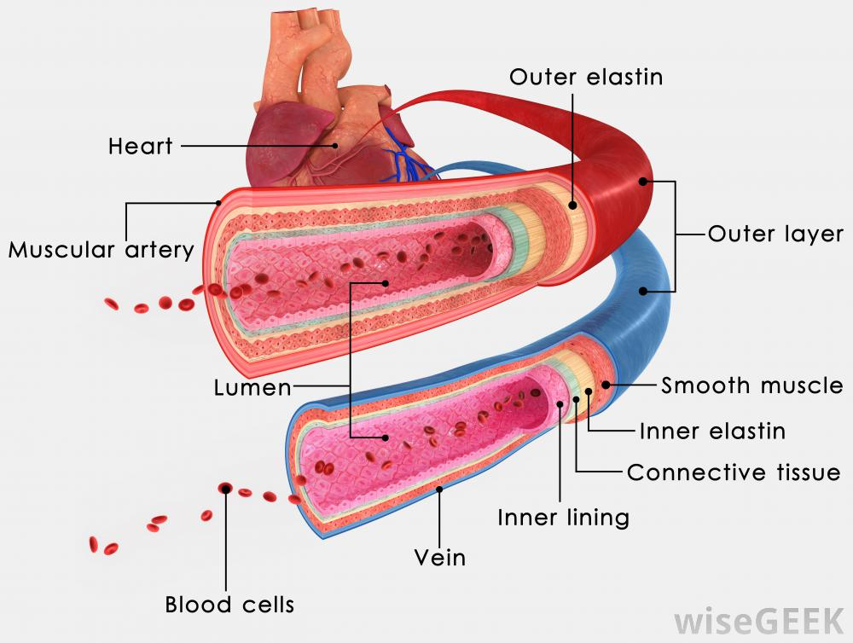
Blood Vessels
Arteries: These are the thicker blood vessels, due to the higher blood pressure.
Arteries carry, usually, oxygenated blood from the heart to the body.
The only artery to carry deoxygenated blood is the Pulmonary Artery.
They have three layers that surround the Lumen.
The interior of a vessel, such as the central space in an artery or vein through which blood flows.
Inner layer that is composed of endothelium (a basement membrane) and an internal elastic lamina.
Middle layer that consists of smooth muscle and elastic tissues.
Outer layer is composed of mainly elastic and collagen fibers.

Slide 13
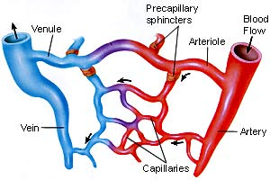
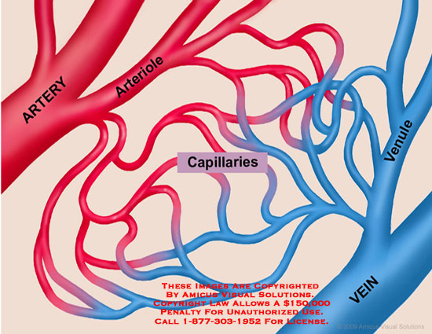
Blood Vessels
Arterioles: Smaller arteries
Capillaries: Small microscopic blood vessels that connect arterioles to Venules.
They are used or exchange of nutrients and oxygen.
They are found in nearly every cell in the body.
( not in the cornea, or cartilage)

Slide 14
Blood Vessels
Veins: Bring Blood from the body to the heart the blood is usually deoxygenated.
The only vein with oxygenated blood is the Pulmonary vein.
Veins are much thinner than arteries but very similar in structure.
Many veins have folds in the inner lining that form valves which Prevent backflow.

Slide 15
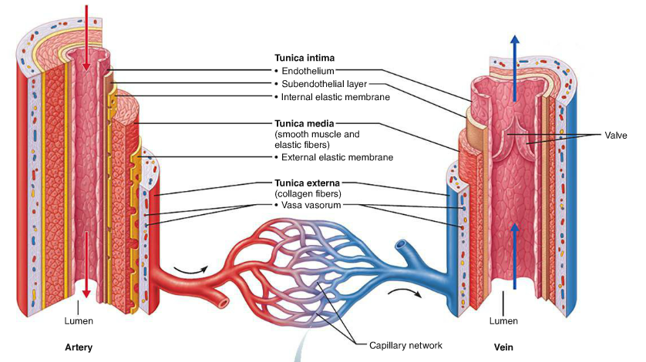
Venules:
Veins: Bring Blood from the body to the heart the blood is usually deoxygenated.
Veins are much thinner than arteries but very similar in structure.
The lumen of the vein is wider than that of an artery.
Many veins have folds in the inner lining that form valves which Prevent backflow.

Slide 16
Blood Vessels
Veins and Venules hold and carry about 60 % of the blood at any 1 time.
Arteries and Arterioles hold about 15 % of the blood and Systemic Capillaries about 5%.
Pulmonary blood vessels 12%, Heart Chambers about 8 %

Slide 17
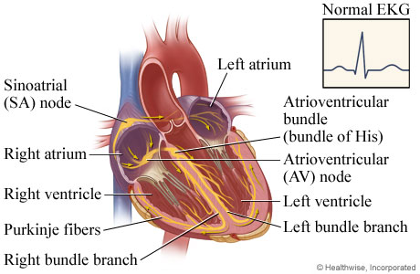
Heart Beats
Sinoatrial Node: 75 Action potentials /min or beats /min : pacemaker for the heart. Initiates movement about 100 times per min faster than any other portion.
Atrioventricular Node: provides the time for the blood to empty from the atrium to the ventricles.
Can become the pacemaker if the SA is damaged or diseased.
Systole: Contraction (Lubb)
Diastole: Relaxation. (Dubb)

Slide 18
Blood
Blood is about 8% of the total body mass and it is slightly alkaline.
About 5 to 6 liters in the body.
Hemopoiesis: the process of forming the formed elements.

Slide 19
Extensions to Mendel
The human ABO blood group system demonstrates:
-multiple alleles: there are 3 alleles of the I gene (I^{A}, I^{B}, and i)
-codominance: I^{A} and I^{B} are dominant to i but codominant to each other

Slide 20
Three alleles are possible at one single gene locus I^{A}, I^{B}, and i.
The enzyme produced by these alleles either adds or does not add a sugar molecule to a protein found in the membrane of the red blood cells.
I^{A} alleles add galactosamine, I^{B} adds galactose, and I does not add any sugar. These Protein /Sugar complex act as an antigen .

Slide 21
Each has two alleles, so Blood type A could be ( I^{A} I^{A} or I^{A} i), Type B ( I^{B} I^{B} or I^{B} i), Type AB ( I^{A} I^{B})
Type O (i i )
The immune system is tolerant to its own antigens but makes antibodies to those that differ. This causes agglutination or clumping of and lysis of foreign red blood cells.

Slide 22
If Blood type A receives type B blood than it is recognizes as foreign and attacked causing them to clump. Same is true if B or AB types are transfused.
If either of these Blood types is given a transfusion with type O blood than there are no antigens so the O blood will be tolerated. That is why Type O blood is known as the Universal Donor.
Because Blood type AB has both antigens ,neither will be foreign, so these patients may receive blood from any of the blood groups. AB then is known as the universal recipient.

Slide 23
Other Antibodies are; IgM, Rh, and IgG antibodies.
IgM work on foreign blood antigens such as carbohydrates on bacteria, even if these carbohydrates are found in our cellular makeup. But they do not act on the carbohydrates that make up the cell.
Rh Factor or Rh antigen : The protein is either present, Rh positive or absent, Rh negative on the surface of RBC. A Rh neg. person who receives a Rh pos. transfusion produces antibodies to the foreign antibodies.

